Slide 1
Class-Objects: Static Variable, Method and Constructor

Slide 2
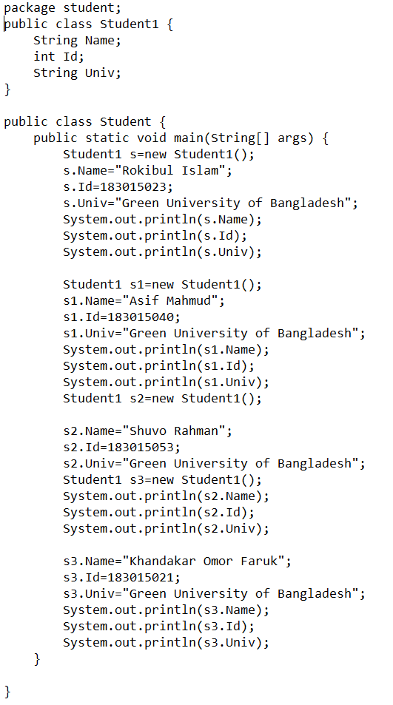
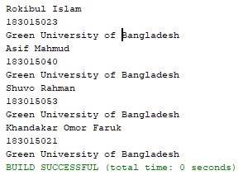
Sample Code: Class-Objects
Output

Slide 3
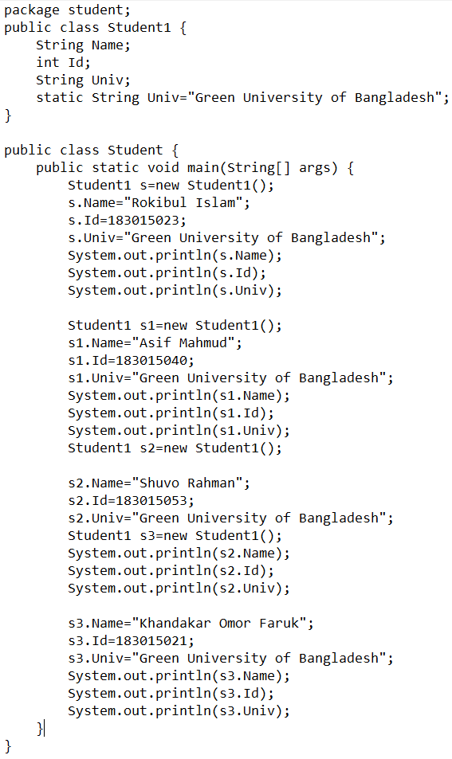
Sample Code: Static Variable
Output

Slide 4
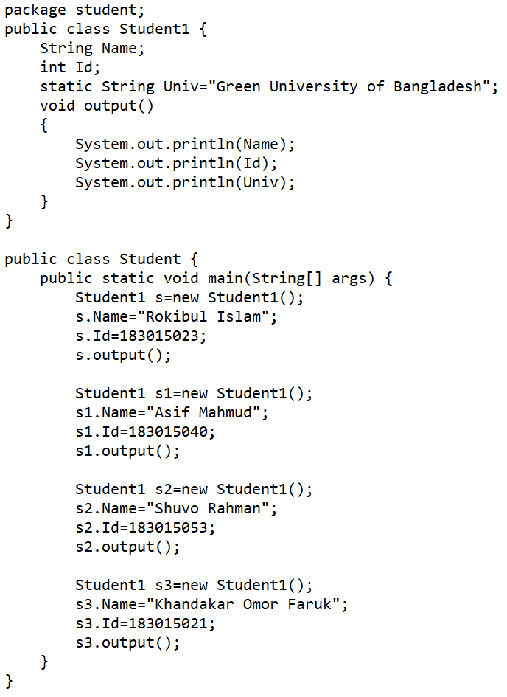
Sample Code: Method
Output

Slide 5
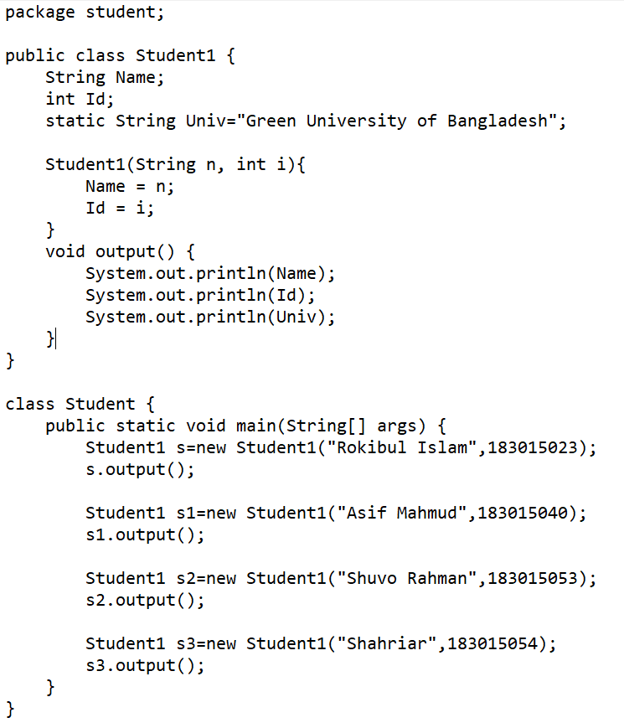
Sample Code: Constructor
Output

Slide 6
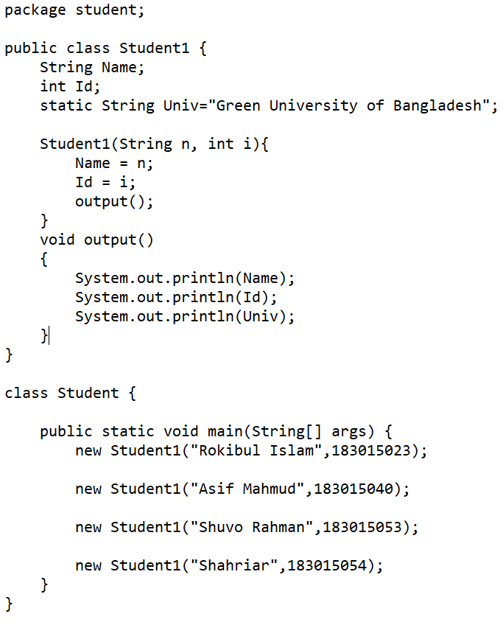
Sample Code: Constructor without object
Output

Slide 7
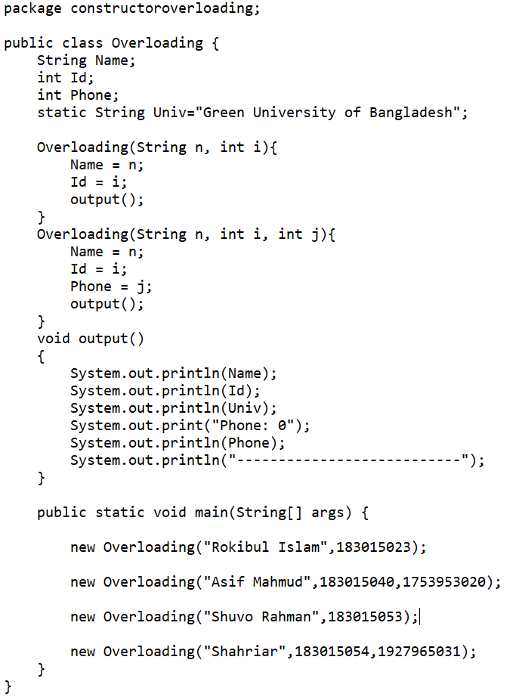
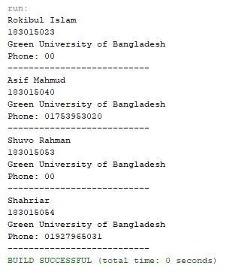
Sample Code: Constructor Overloading
Output

